Slide 1

Video Sharing Website Analysis
Fu Wang
Jiaxi Fang
Yizhou Zhao
Ruiyu Zhang

Slide 2

Framework
Pre-clean the raw data through Python and then import to SQL
Manipulated relevant data in SQL to generate a suitable data frame
Connect database to tableau for visualization and dashboard

Slide 3
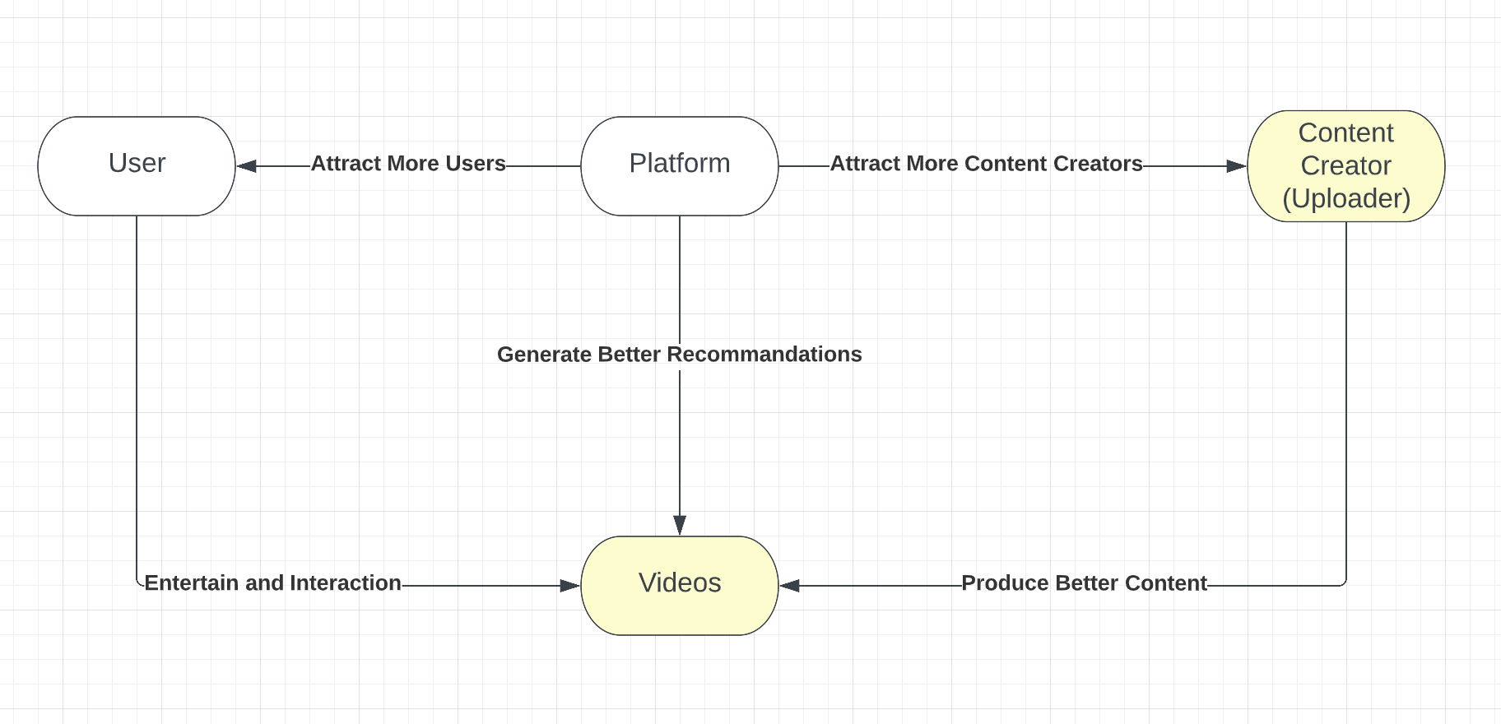
Business Idea
Objective
Get more users and more content creators
Strategy
Giving user more interesting contents
Positive reward and promotion for content creator
Metric
Interaction Rate
Uploader active rate
Uploader increment

Slide 4
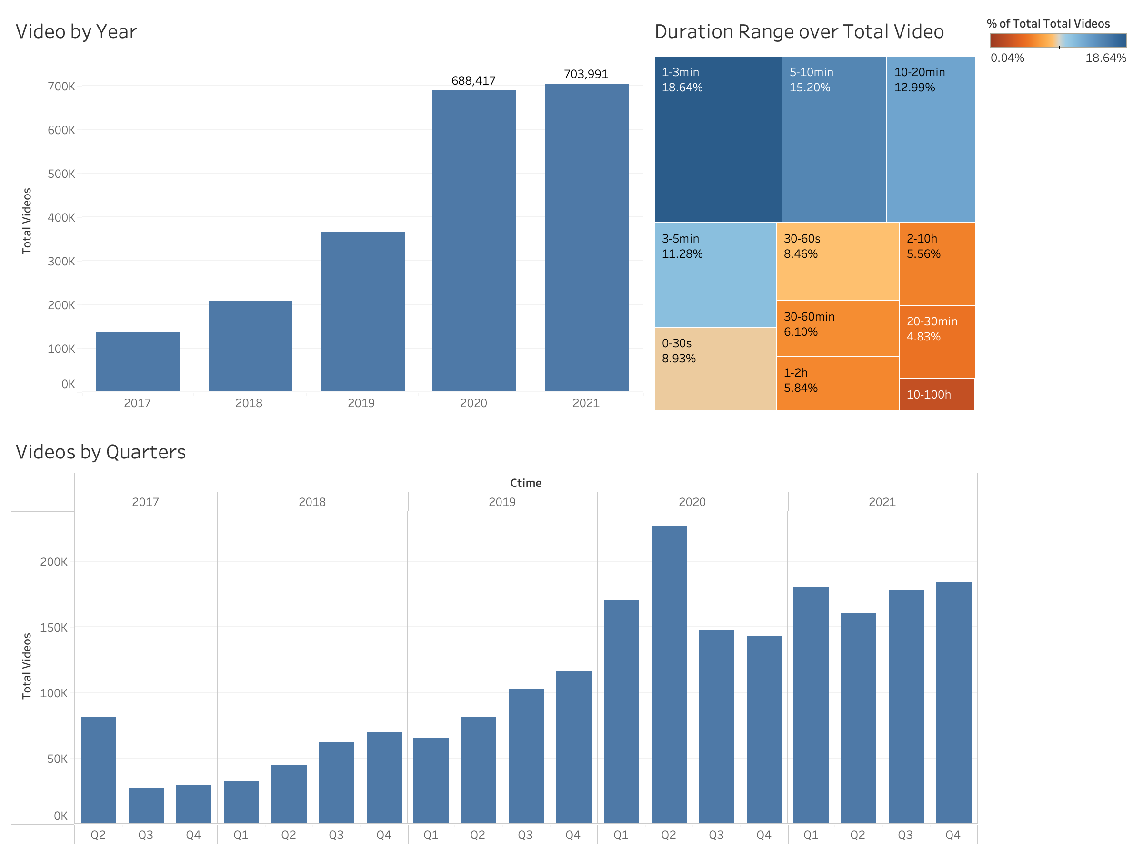
Video Trend Analysis
We can see more and more uploaders are uploading videos over the years
The first two quarters in 2020 had a very large increment that was due to the others famous content creators from other platforms were stepping into this platform
Most videos are between 1 min and 20 min long

Slide 5
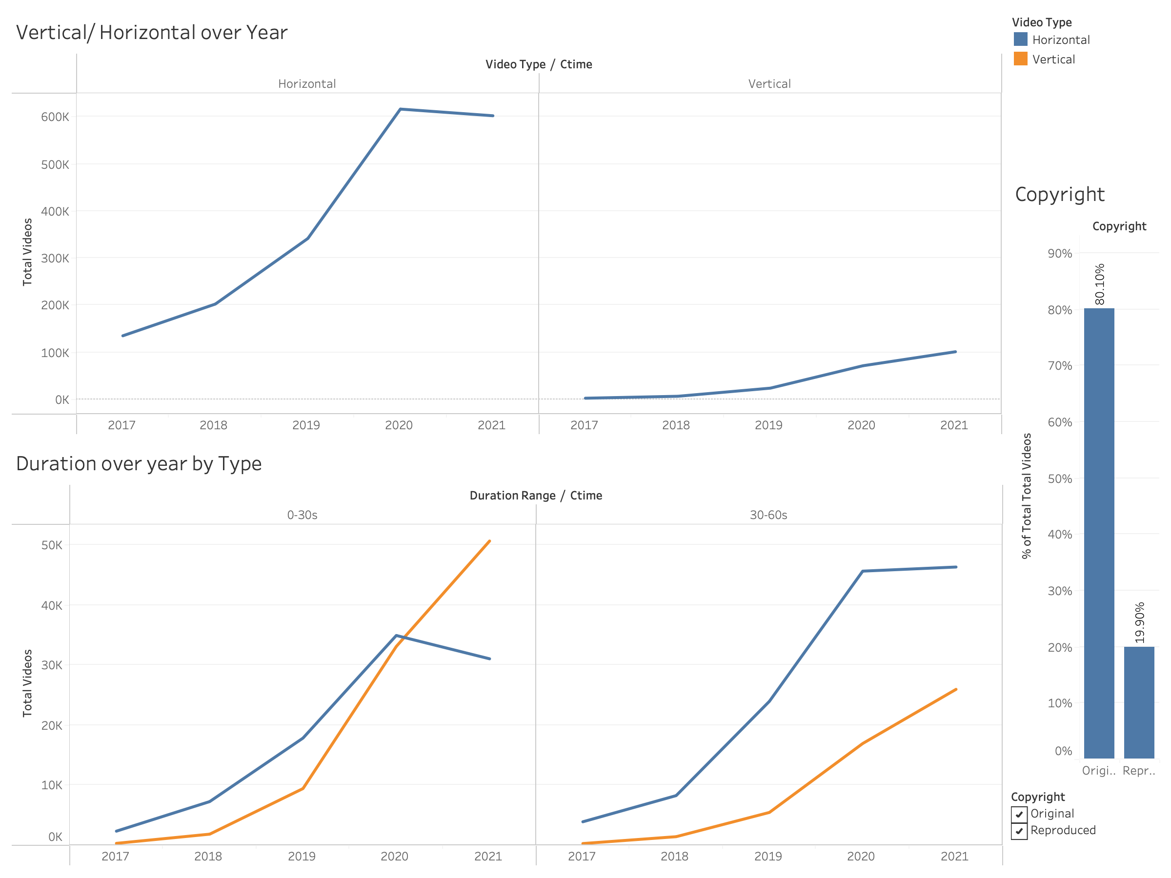
Video Type Analysis
The vertical type of videos keeps increasing over years suggesting that more and more ppl are creating and watching contents on their phones
The number of short videos are increasing over years as well, suggesting the raise of short video platforms like TikTok

Slide 6
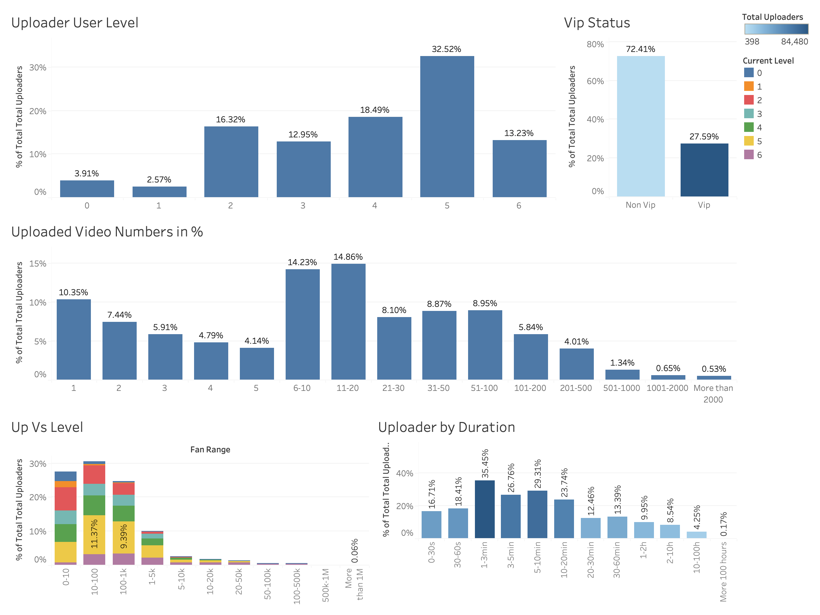
Uploader Analysis
Most Uploaders user level are between 2 and 5, level 5 has the highest percentage 32.52% correspond to 42.4% to be a VIP user
Level 6 uploaders have the highest fan group and usually uploaded 6 – 200 videos, and only level 6 have fan groups size more than 1 M

Slide 7
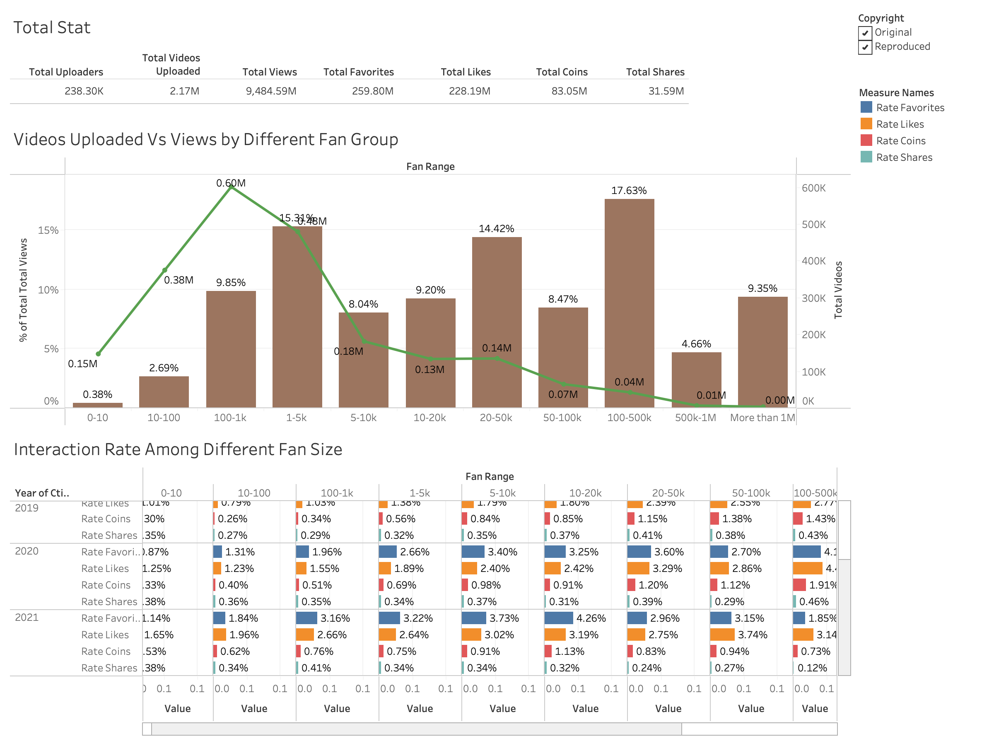
Video/view Analysis
Original Video has more views than reproduced videos
Uploaders with more than 1M followers is less than 0.1% but contribute to 9.35% total views
Uploaders with followers less than 100 uploaded about 15% videos yet don’t even receive 3% views

Slide 8
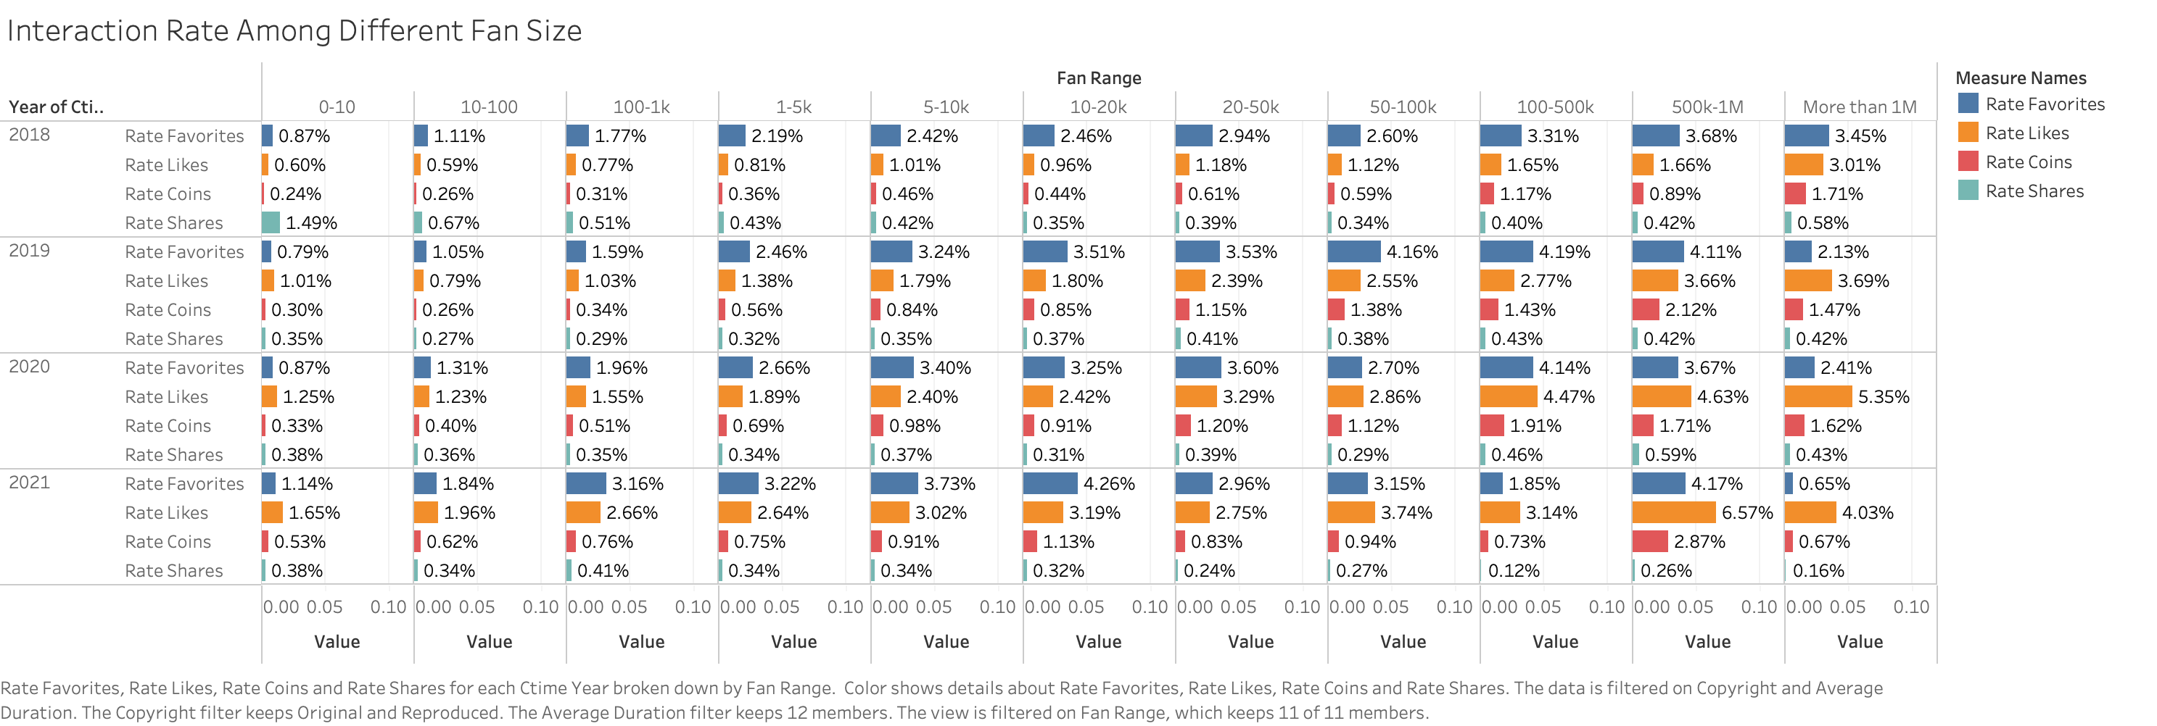
Interaction Analysis
When the uploaders’ followers are more than 10k, the interaction rate is getting better noticeably.
When the uploader’s have followers' range between 5k and 500k, they have more favorites than likes, this is due to the fact their contents are more in depth than for general users
Uploaders with more than 500k followers tend to have contents fitting for common audiences’ tastes

Slide 9
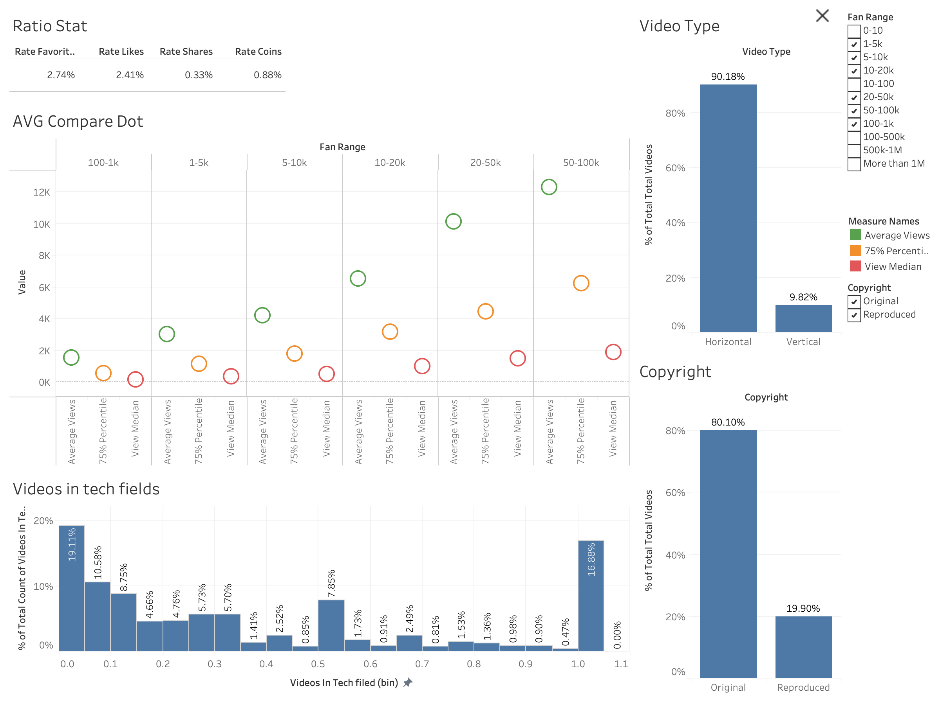
Uploader Analysis
Strong Matthew effect can be seen here that the average views per Video is much higher than the 75 percentile and median of views
More than half of the uploaders are not focused on the tech fields and only 35.9% uploaders are the main content creator

Slide 10
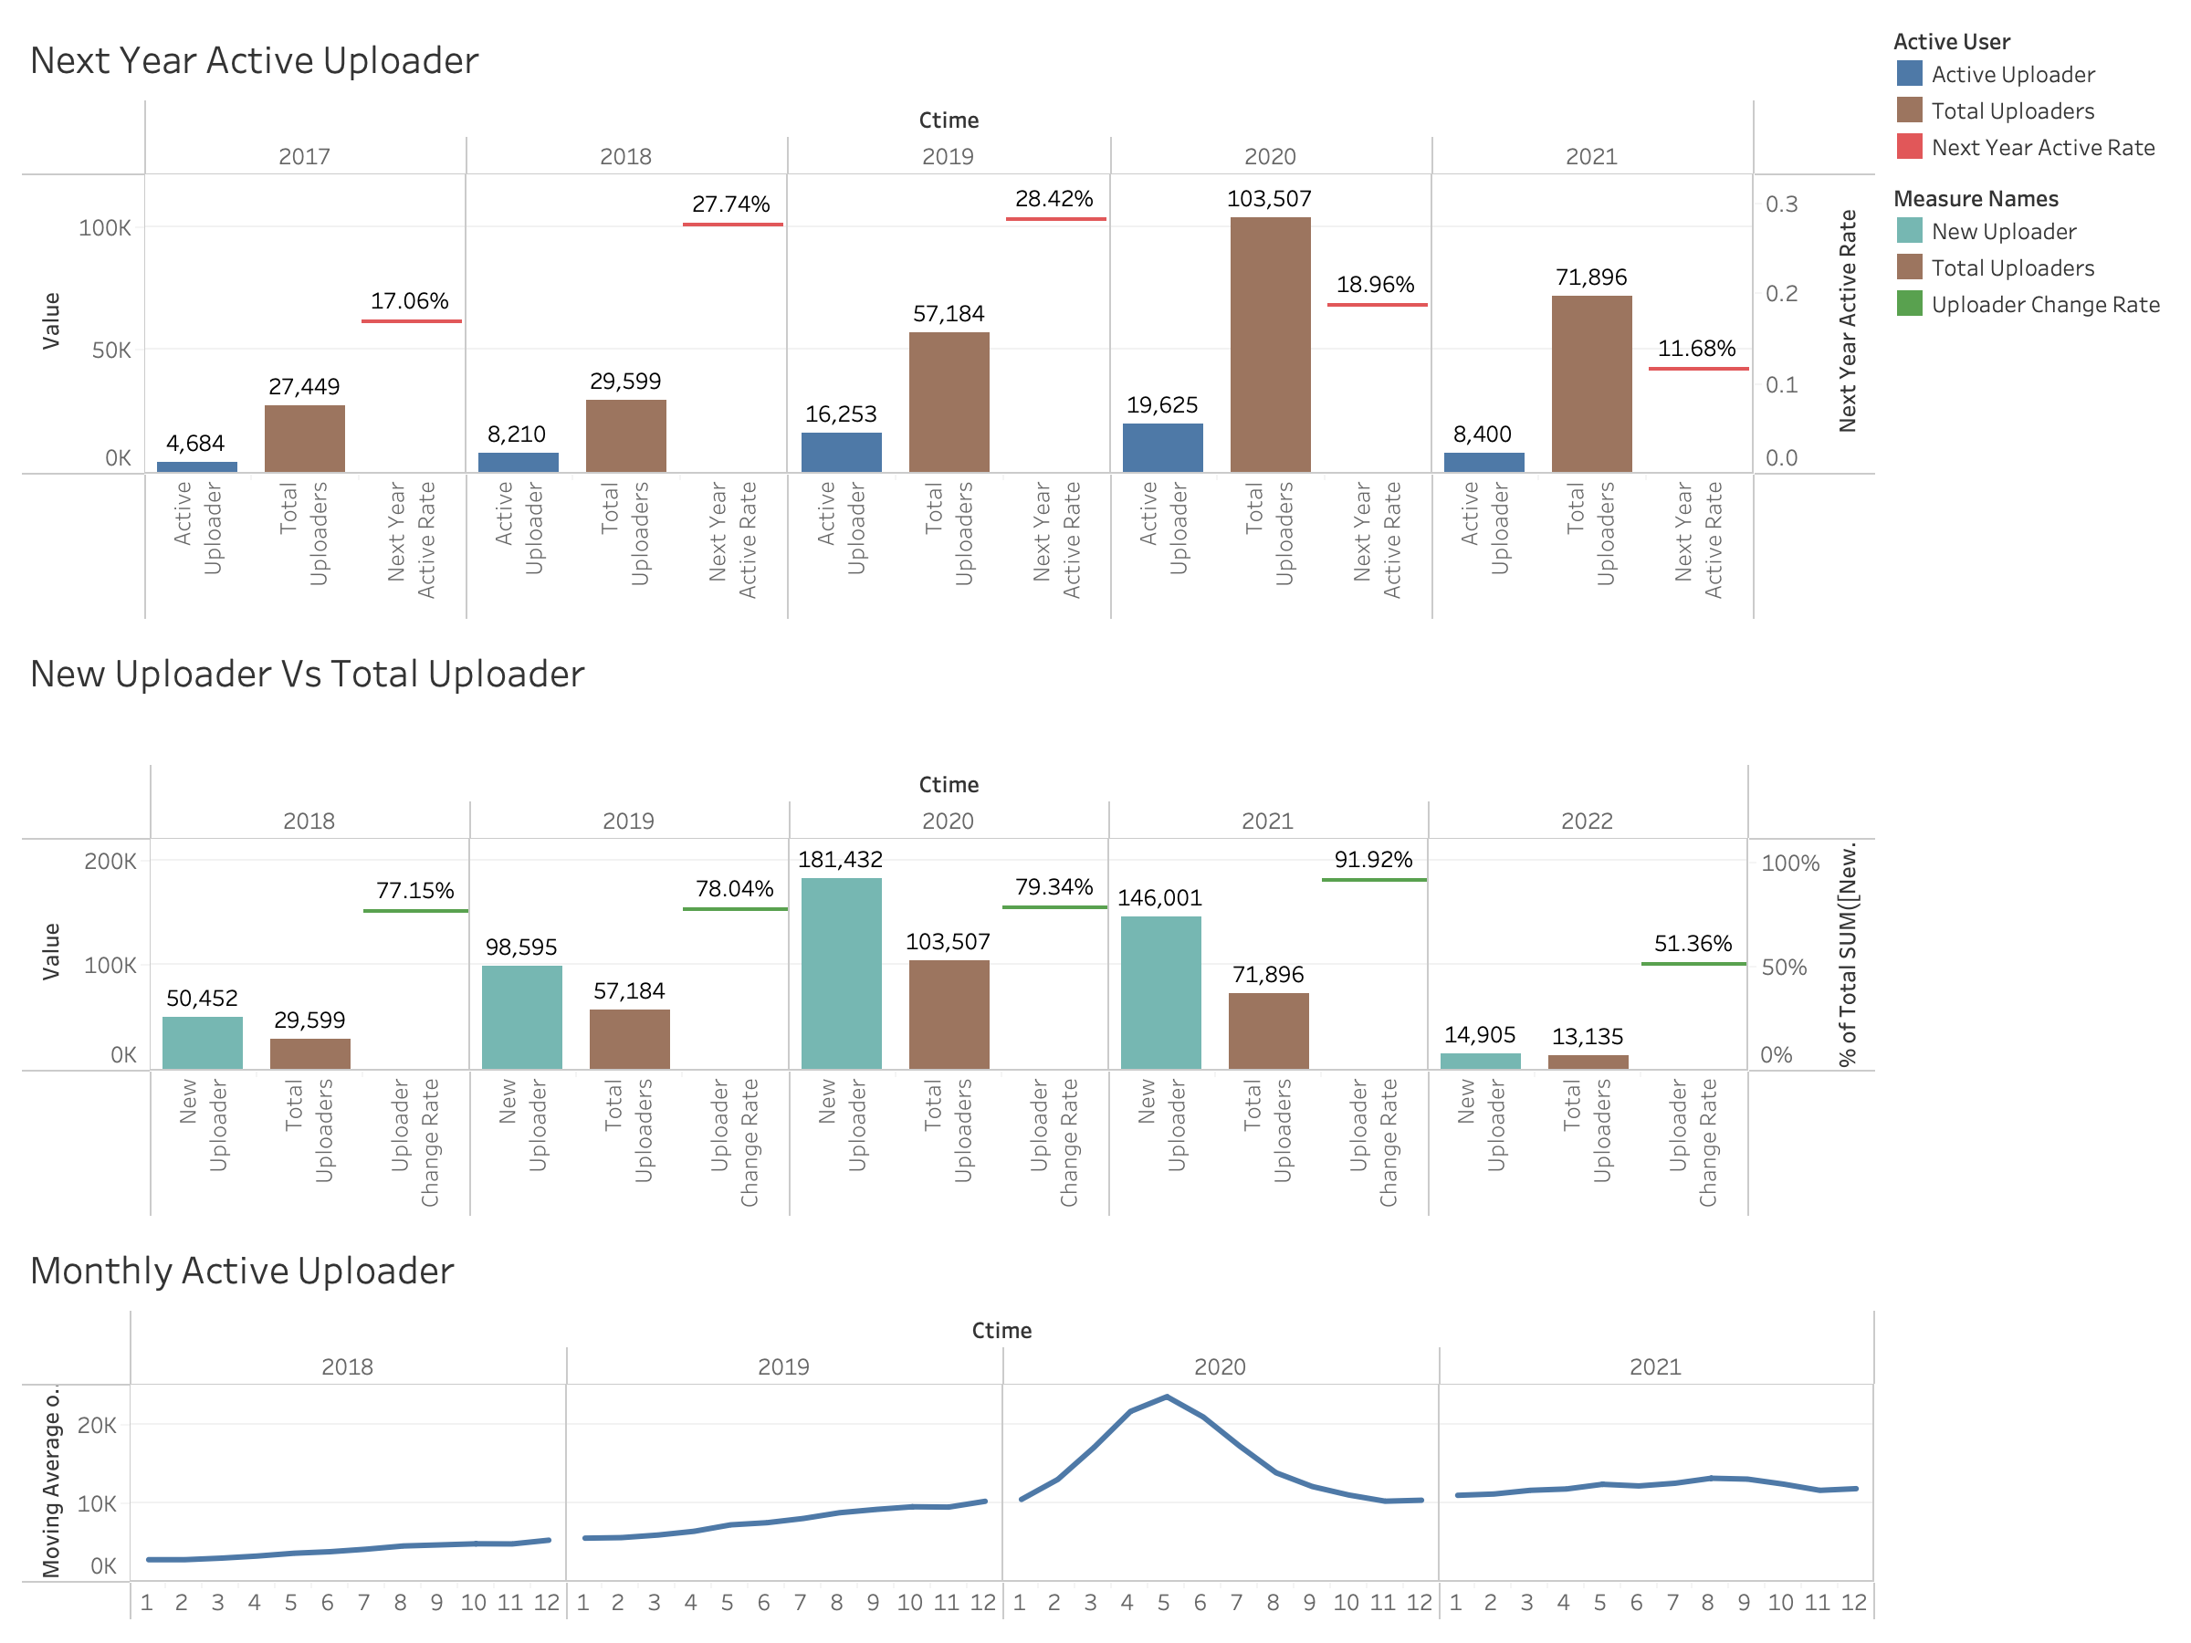
Uploader Analysis
In the year 2017, 2018, 2019, the rate of uploaders remain still activate is increasing
In the year of 2018, 2019, 2020, 2021 we can see more and more content creator are joining in the community
This suggests the platform, is lacking in certain perspectives to keep uploaders stay activate

Slide 11
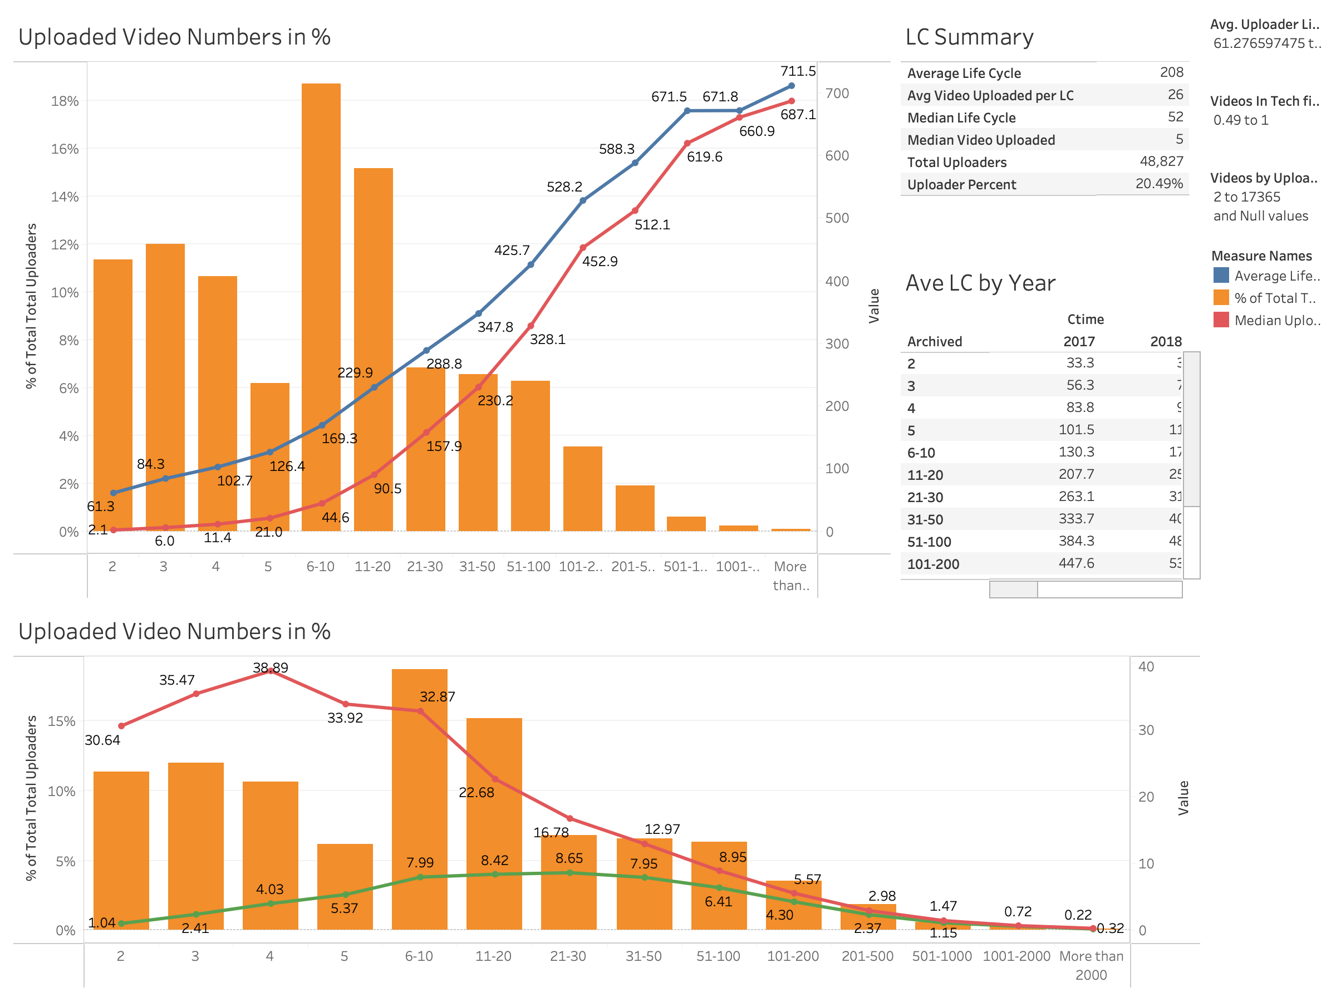
Uploader Analysis
Here we focus on uploader who uploaded more one videos and are the main content creator in tech field
We can see when they uploaded more than 30 vides, they are more likely to keep staying in the platform and keep creating content
When they have more work uploaded, they will have a higher tendency to create work in a fast pace

Slide 12
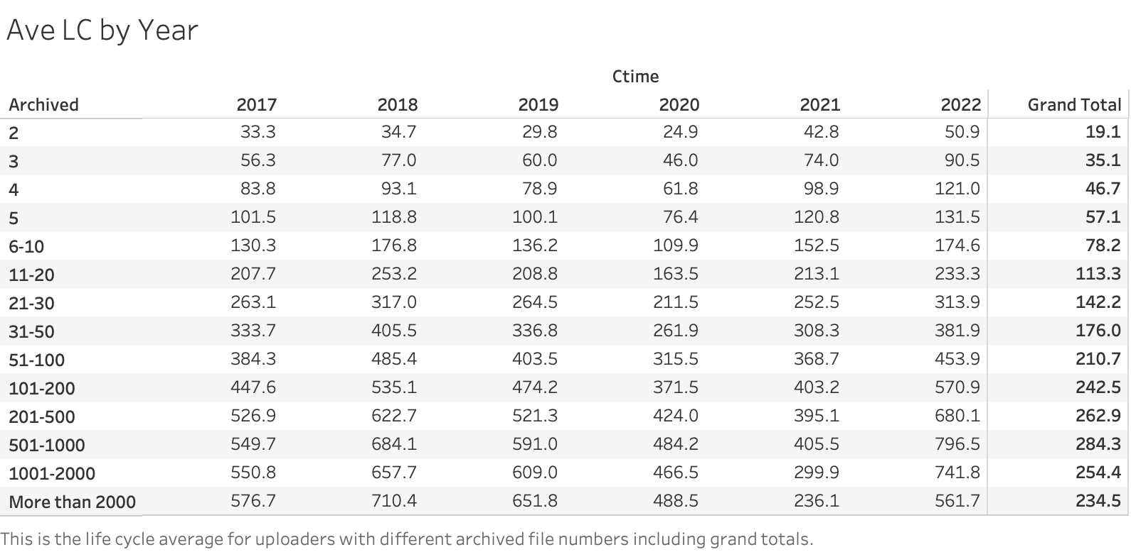
Interesting Finding
The average in each columns are all larger than the Grand Total Average

